Slide 1
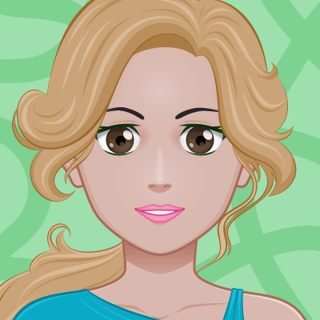
THIS IS MICHELLE
She is a university
student and
she wants to be
a veterinarian.
She has a boyfriend.

Slide 2
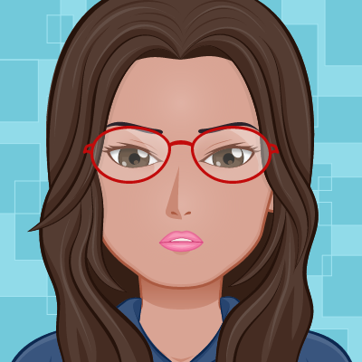
THIS IS MICHELLE’S FRIEND
Her name is Diana.
She has a boyfriend
and she likes to party!!!!
She loves going to the
cinema…

Slide 3

Look at
Michelle's routine

Slide 4
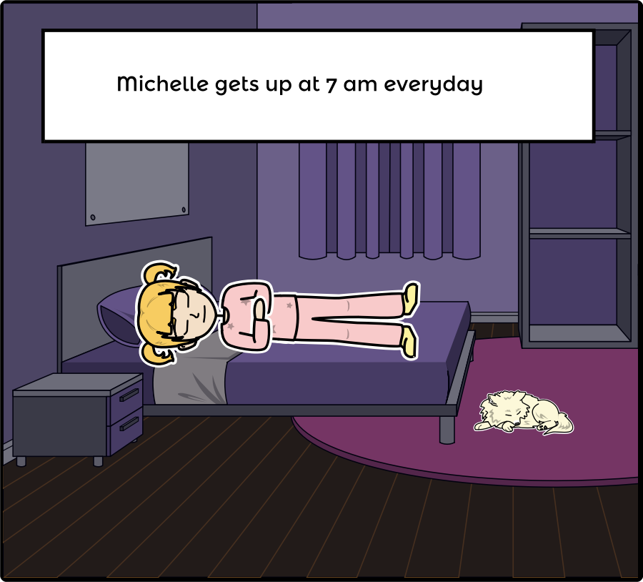
LOOK
Add Text Here

Slide 5
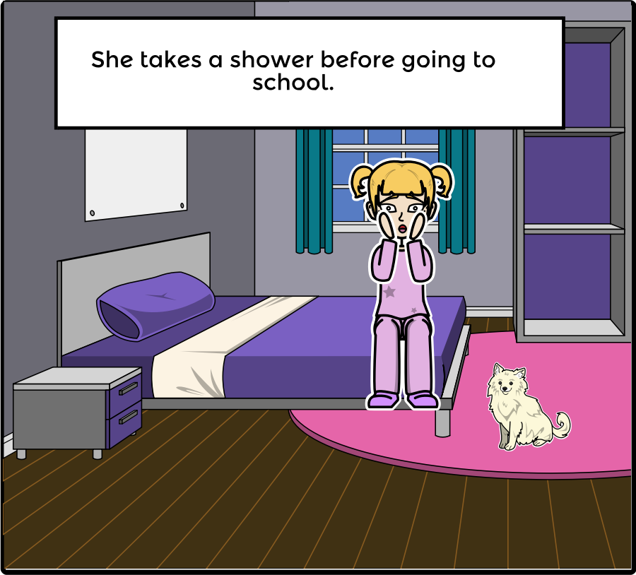
AFTER THAT
Add Text Here

Slide 6
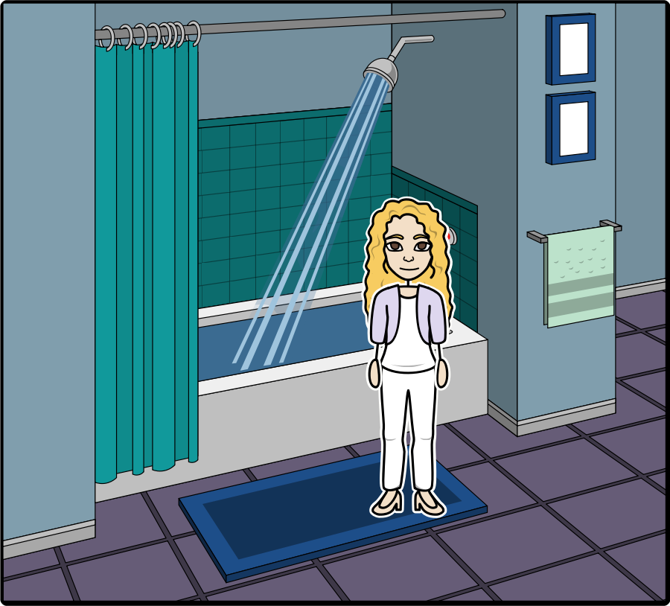
THEN
Add Text Here

Slide 7
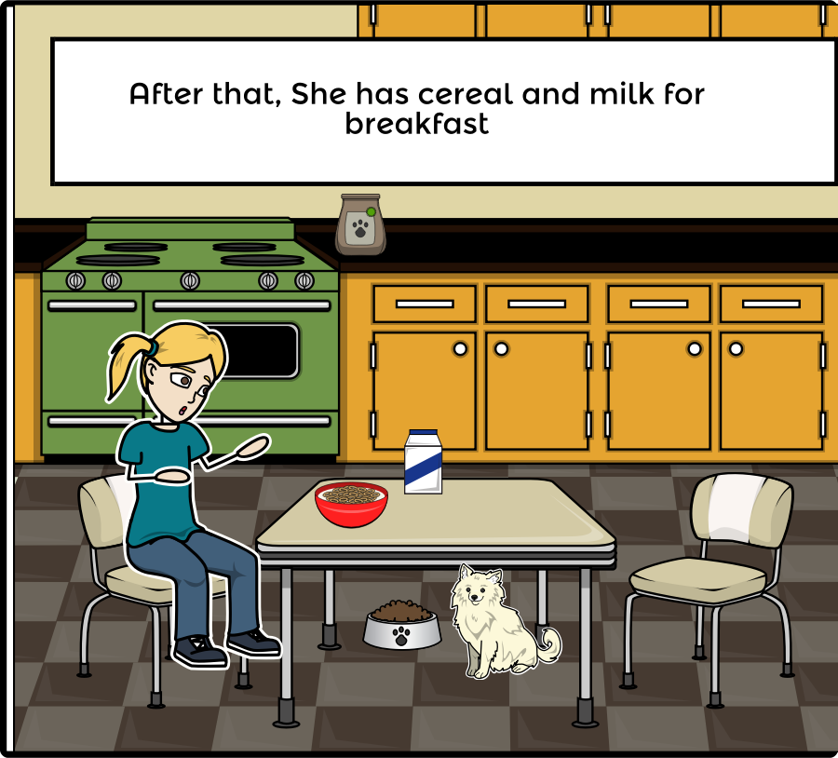
AROUND 7:45
Add Text Here

Slide 8
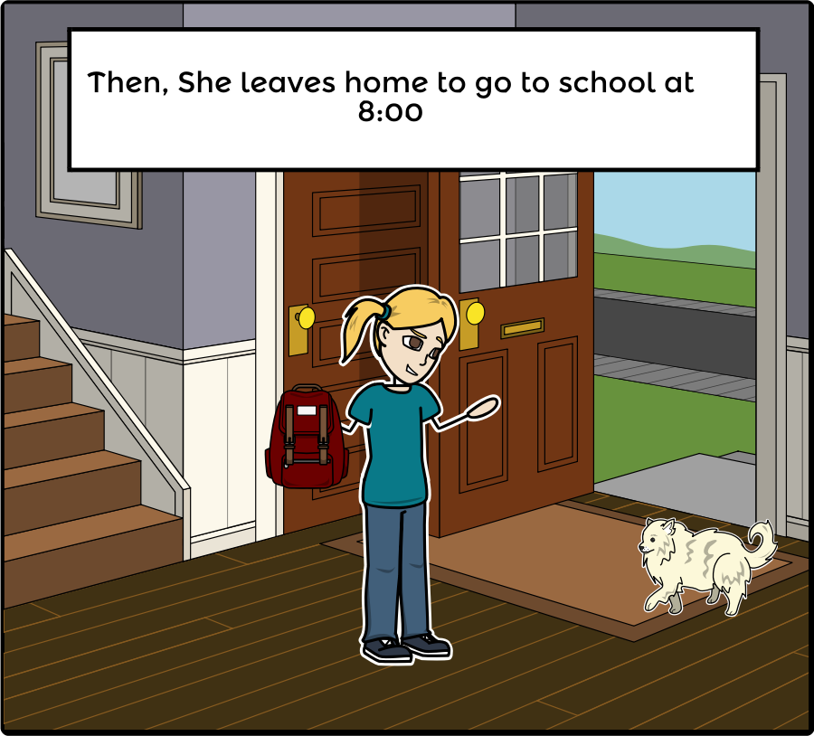
AT 8:00
Add Text Here

Slide 9
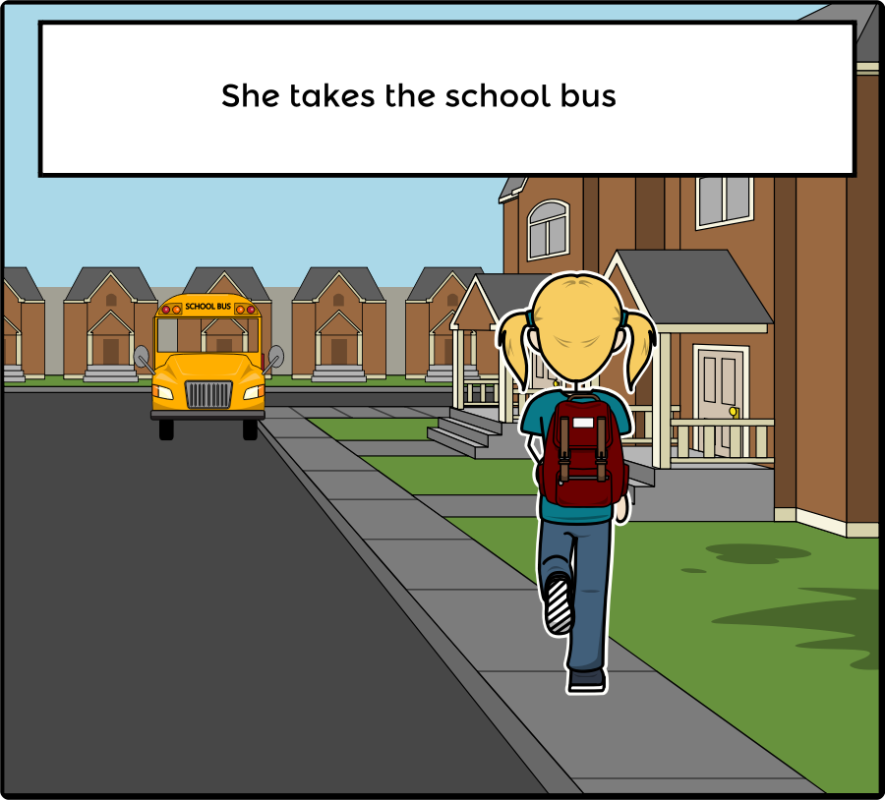
AROUND 8:15…
Add Text Here

Slide 10
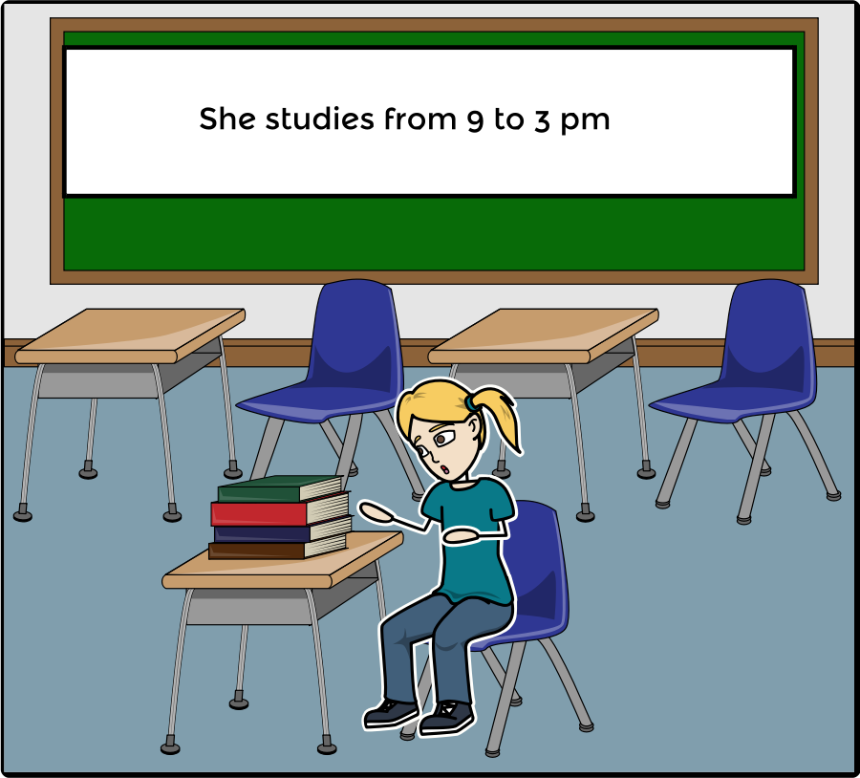
AND
Add Text Here

Slide 11
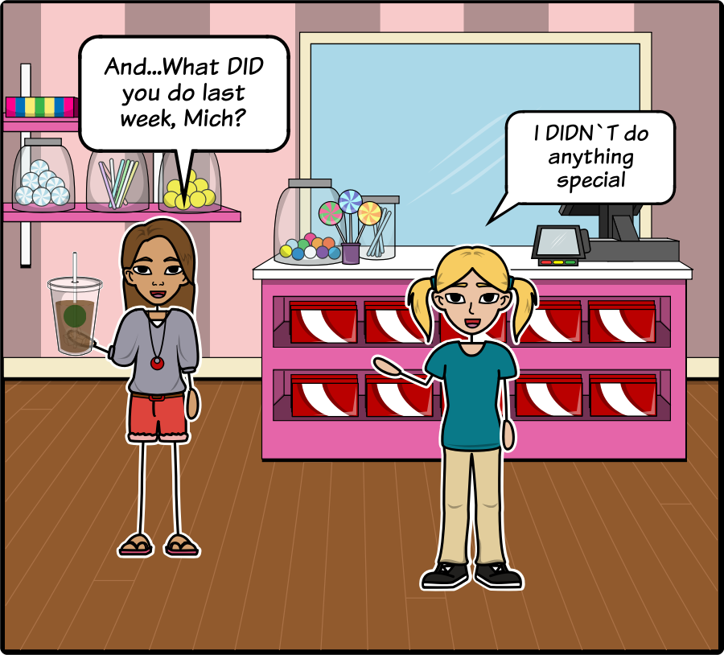
IT IS SATURDAY. MICHELLE AND DIANA ARE IN A COFFEE SHOP. DIANA ASKS MICHELLE ABOUT HER ACTIVITIES LAST WEEK.
Add Text Here

Slide 12
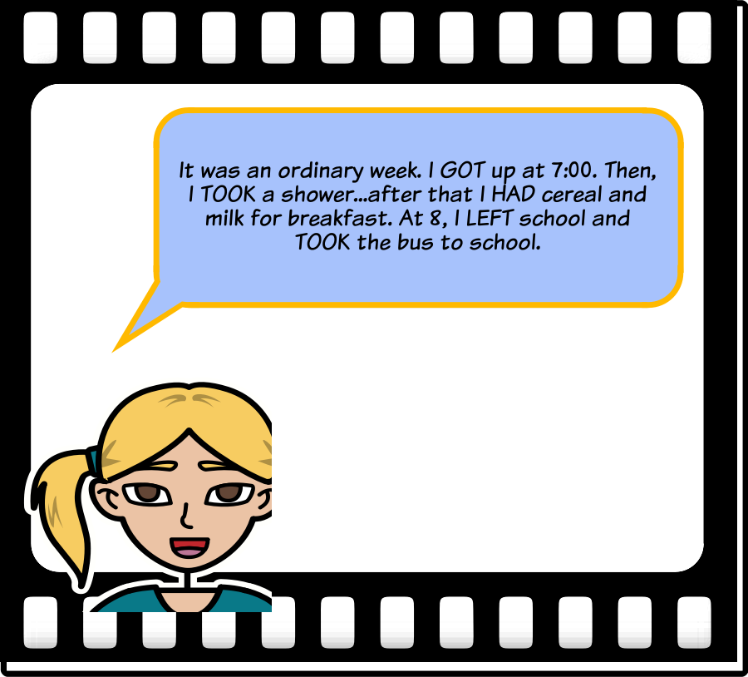
SHE DESCRIBES HER ACTIVITIES IN THE PAST.
Pay attention to the words in capital letters.
GOT, TOOK, HAD, LEFT and TOOK.
They are verbs in PAST TENSE.
home

Slide 13
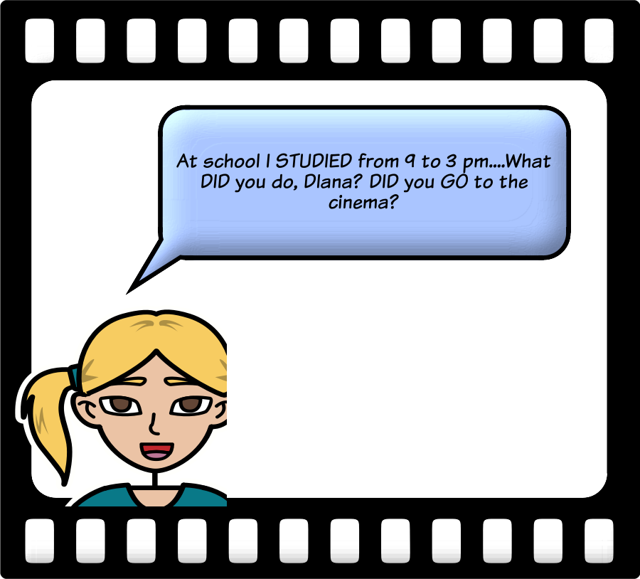
THERE ARE MORE ELEMENTS IN THE SIMPLE PAST TENSE.
STUDIED is a verb in past too.
But, what is DID? where do you find it?
In questions and negative ideas!
IT IS THE AUXILIARY VERB FOR PAST ACTIONS!

Slide 14
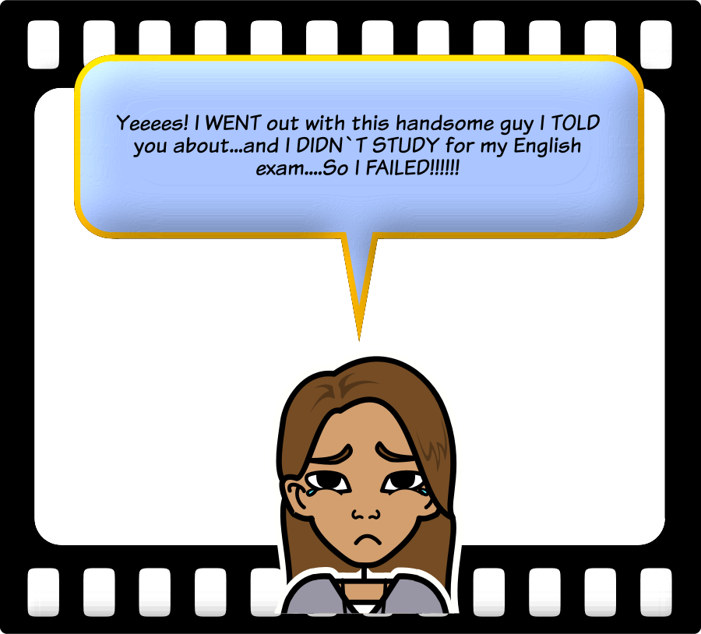
MICHELLE ASKED DIANA ABOUT HER ACTIVITIES. DIANA ANSWERS.
Here the words in capital letters are:
WENT, TOLD, FAILED
They are also verbs in past.
You can see the words DIDN`T STUDY. You need the auxiliary verb for past (DID) in questions and negative sentences.

Slide 15
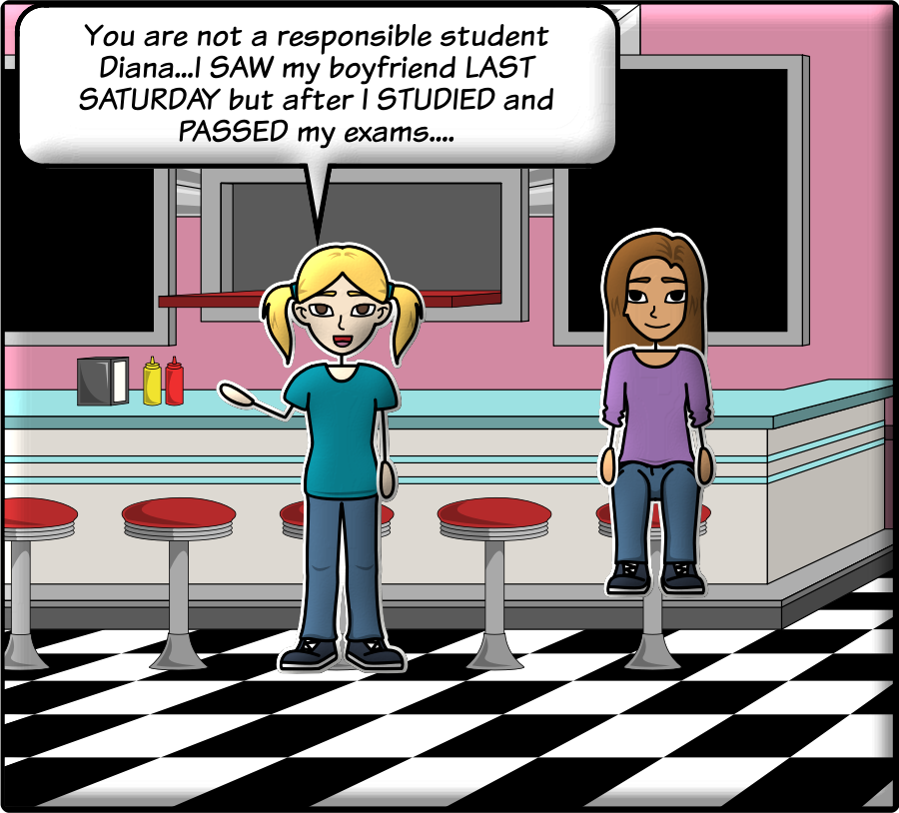
AND THEN
Again, we have words related to the past:
SAW, STUDIED and PASSED are verbs in past tense.
LAST SATURDAY is a Time expression for the past.

Slide 16
The simple past tense

Slide 17
USE OF SIMPLE PAST
COMPARE TO SIMPLE PRESENT
We use the simple past to describe actions that started and finished in the past at a certain time.
We can express this time with expressions like: LAST MONTH, LAST YEAR, YESTERDAY, LAST WEEK.
10 MINUTES AGO, AN HOUR AGO, THREE DAYS AGO, A WEEK AGO, THE DAY BEFORE YESTERDAY, YERTERDAY AFTERNOON.
IN 2007, IN 1999.
You know that to describe routines and habits in affirmative and negative we use an auxiliary: DO (for I, YOU, WE, THEY) or DOES (for HE, SHE, IT) Remember?
Here you have some examples for you:
He doesn’t work.
She doesn’t have a boyfriend.
Does she like pop rock?
Does he study medicine?

Slide 18
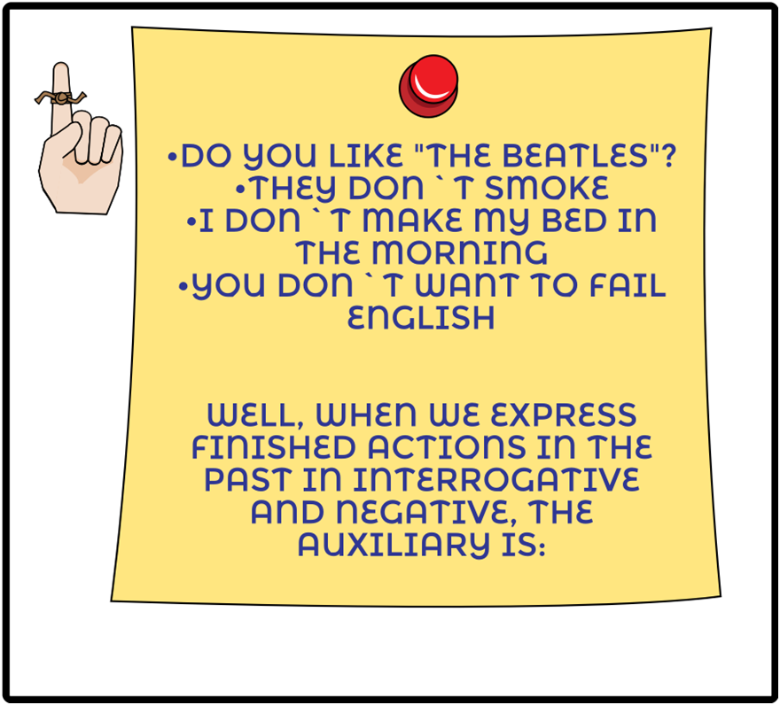
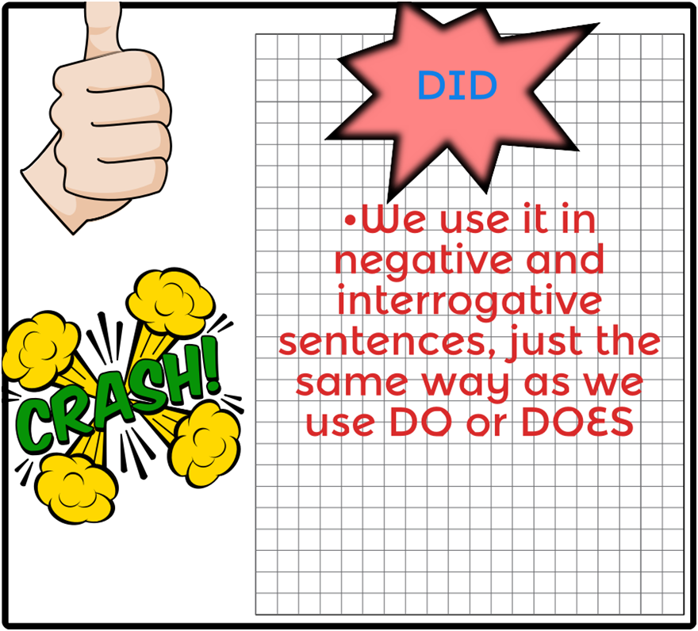
SIMPLE PRESENT
AUXILIARY FOR PAST

Slide 19
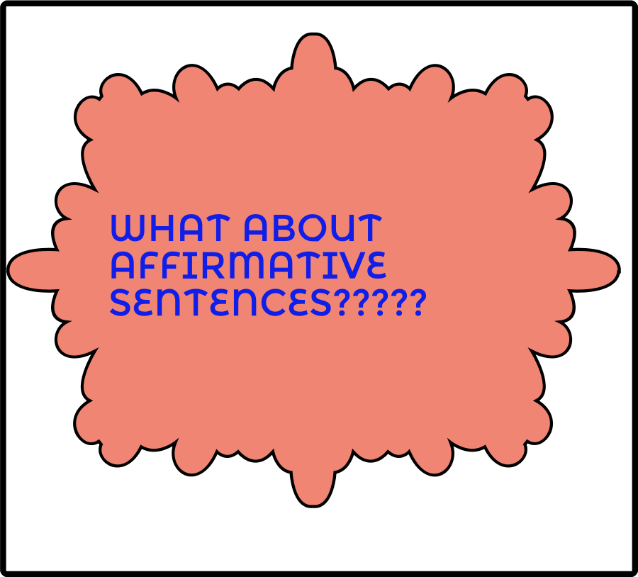
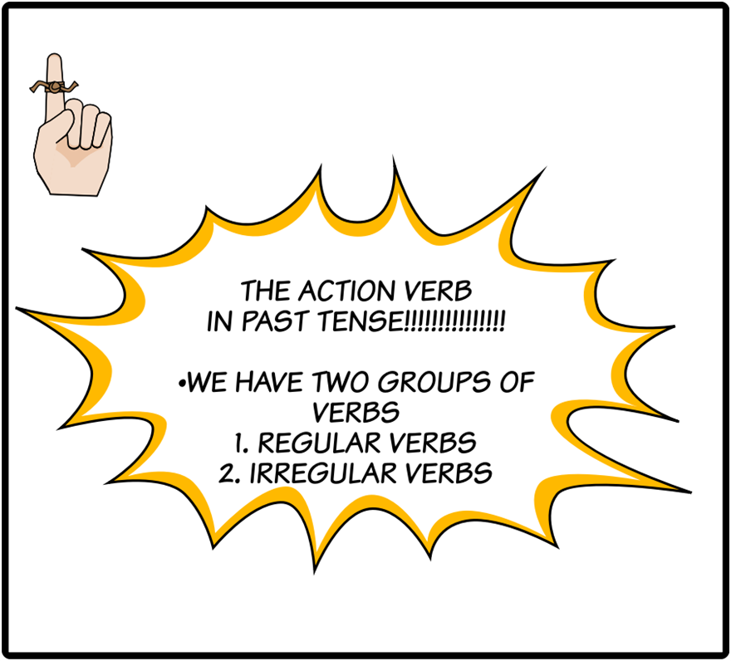
REMEMBER!
Add Text Here

